Slide 1
MSML 604 - Introduction to Optimization
Convex Optimization for
Retrieval-Augmented Generation
Pipeline Tuning
Learning retrieval signal weights via constrained Quadratic Programming
Sahil Chaudhari · Sakshaat Raut · Ritika Karande
github.com/Lord2709/RAG-Convex-Optimization

Slide 2
Motivation: Why Optimize RAG Weights?
Modern RAG pipelines combine three retrieval signals:
Key Questions
Dense cosine similarity
1
Is the weight learning problem convex?
semantic embedding match
BM25 lexical score
exact keyword overlap
Does a convex relaxation lose accuracy vs. non-convex?
2
MMR diversity
coverage & redundancy reduction
3
When does MMR diversity add value?
Weights are typically set by hand, but what is the true optimization structure?

Slide 3
Our Novel Contributions
1
New Problem Formulation
2
Theoretical Derivation via KKT Analysis
We cast RAG retrieval weight learning as a constrained QP on the probability simplex, a formulation not previously applied to this problem, and formally prove the full joint problem is NP-hard.
We prove analytically via KKT complementary slackness that the MMR diversity weight is inactive at the optimum for single-answer factual QA. This is derived from first principles, not merely observed empirically.
3
Empirical Relaxation Gap Measurement
4
Lambda Regularization Sensitivity Analysis
We quantify exactly how much accuracy the convex formulation sacrifices vs. the non-convex optimizer, a 3.0% gap on Recall@5. This is an original empirical contribution specific to RAG retrieval.
We systematically sweep λ across 5 orders of magnitude (10⁻⁴ → 10¹) and show that learned weights are remarkably stable, demonstrating practical robustness of the QP formulation.

Slide 4
Problem Formulation: The QP
minimize
‖Xw − y‖² + λ‖w‖²
subject to
w ≥ 0 and Σwᵢ = 1 (probability simplex)
Unique global minimum guaranteed for λ > 0
Solved via CVXPY + OSQP
X
w
y
λ
Feature matrix
[cosine | BM25 | MMR]
Weight vector
[wc, wb, wd]
Binary relevance
labels ∈ {0,1}
L2 regularization
strength (λ > 0)

Slide 5
Optimization Structure
✓ Weight Learning Subproblem
✗ Full Joint Problem (NP-Hard)
Strongly convex QP, Hessian H = 2(XᵀX + λI) is positive definite for λ > 0
Jointly learns w AND selects k-subset from n candidates
Constraint set is the probability simplex, a convex polytope
Subset selection: C(n,k) possible combinations, combinatorial & NP-hard
Unique global minimum guaranteed
Downstream generation loss non-differentiable w.r.t. w when selection depends on w
Solved efficiently in milliseconds via CVXPY + OSQP
Non-convex → multiple local minima
Strong duality holds (Slater's condition satisfied)
Comparison: Nelder-Mead on Recall@k directly (gradient-free)

Slide 6
KKT Conditions & the Diversity Finding
KKT Stationarity at optimal w*:
Key Finding
2(XᵀX + λI)w* − 2Xᵀy + μ1 − ν = 0
w_diversity* = 0.000
μ ∈ ℝ (simplex multiplier) ν ≥ 0 (non-negativity multiplier)
Convex QP & Non-Convex
Complementary Slackness:
νᵢ · wᵢ* = 0 for each i
KKT proves diversity weight hits its lower bound ν_d > 0
If wᵢ* = 0 (active bound), νᵢ > 0, gradient still pushes toward zero.
MMR gain per doc < regularization penalty on TriviaQA
Dual Problem (strong duality via Slater's):
Single-answer factual QA does not benefit from diversity
max − ¼λ‖μ1 + Xᵀy‖² − μ
Finding holds across all λ values (confirmed empirically)
Duality gap = 0 · Primal = Dual at optimum

Slide 7
Methodology: End-to-End Pipeline
1
2
3
4
5
TriviaQA
Dataset
BM25 + FAISS
Retrieval
Feature
Extraction
QP / Nelder-
Mead Opt.
Evaluation
& LLM
150 train
50 test
Candidate
docs
X matrix
[n × 3]
Learn
weights w
Recall@k
EM, F1
Feature vector x(q, dᵢ) = [ cosine(q, dᵢ), BM25(q, dᵢ), MMR(dᵢ, R) ] , score(q, dᵢ) = wᵀx(q, dᵢ)
Systems compared: Convex QP · Non-Convex (Nelder-Mead) · Equal Weights · Cosine Only · BM25 Only
TriviaQA rc.wikipedia · 150 train / 50 test queries · all-MiniLM-L6-v2 embeddings · FAISS + rank-bm25 · Groq LLM eval

Slide 8
Experimental Setup
Dataset: TriviaQA (rc.wikipedia)
Systems Compared
150
50
System | Approach
Convex QP | Constrained QP on simplex (our main)
Non-Convex | Nelder-Mead on Recall@k directly
Equal Weights | Uniform w = [1/3, 1/3, 1/3]
Cosine Only | w = [1, 0, 0]
BM25 Only | w = [0, 1, 0]
Train Queries
Test Queries
356
10
Corpus Docs
Retrieved per Q
• Embedding model: all-MiniLM-L6-v2
• FAISS approximate nearest neighbour
• rank-bm25 for sparse retrieval
• λ = 0.01 | Solver: OSQP

Slide 9
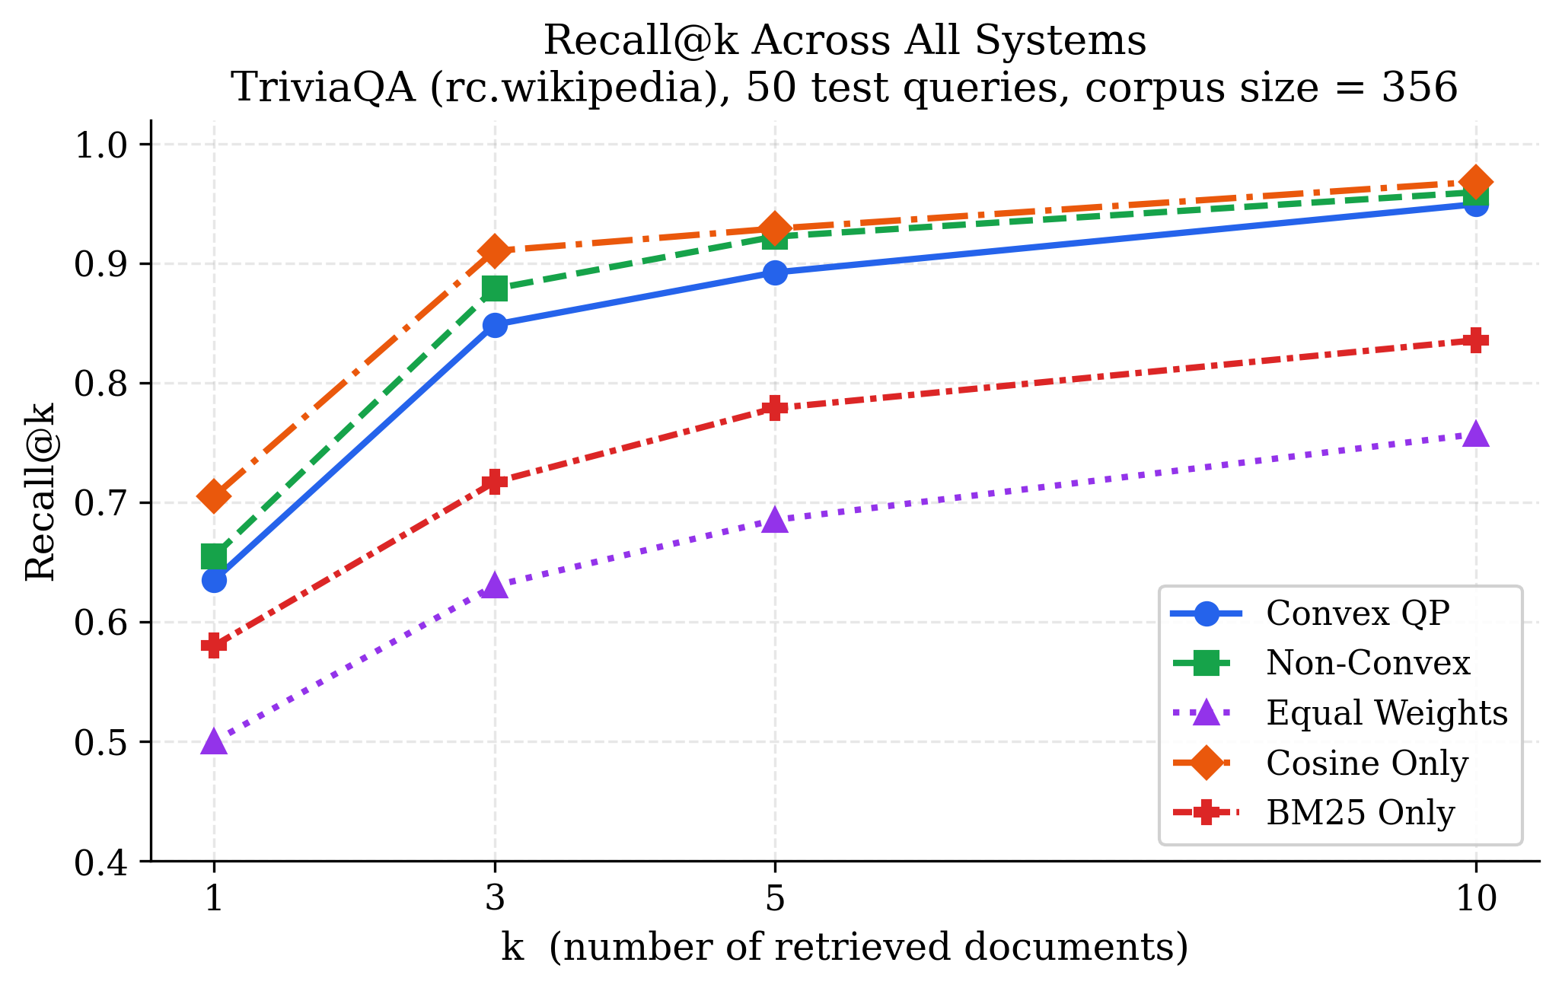
Retrieval Performance: Recall@k
0.892
Convex QP
Recall@5
0.922
Non-Convex
Recall@5
3.0%
Relaxation
Gap
0.500
Equal Weights
Recall@5

Slide 10
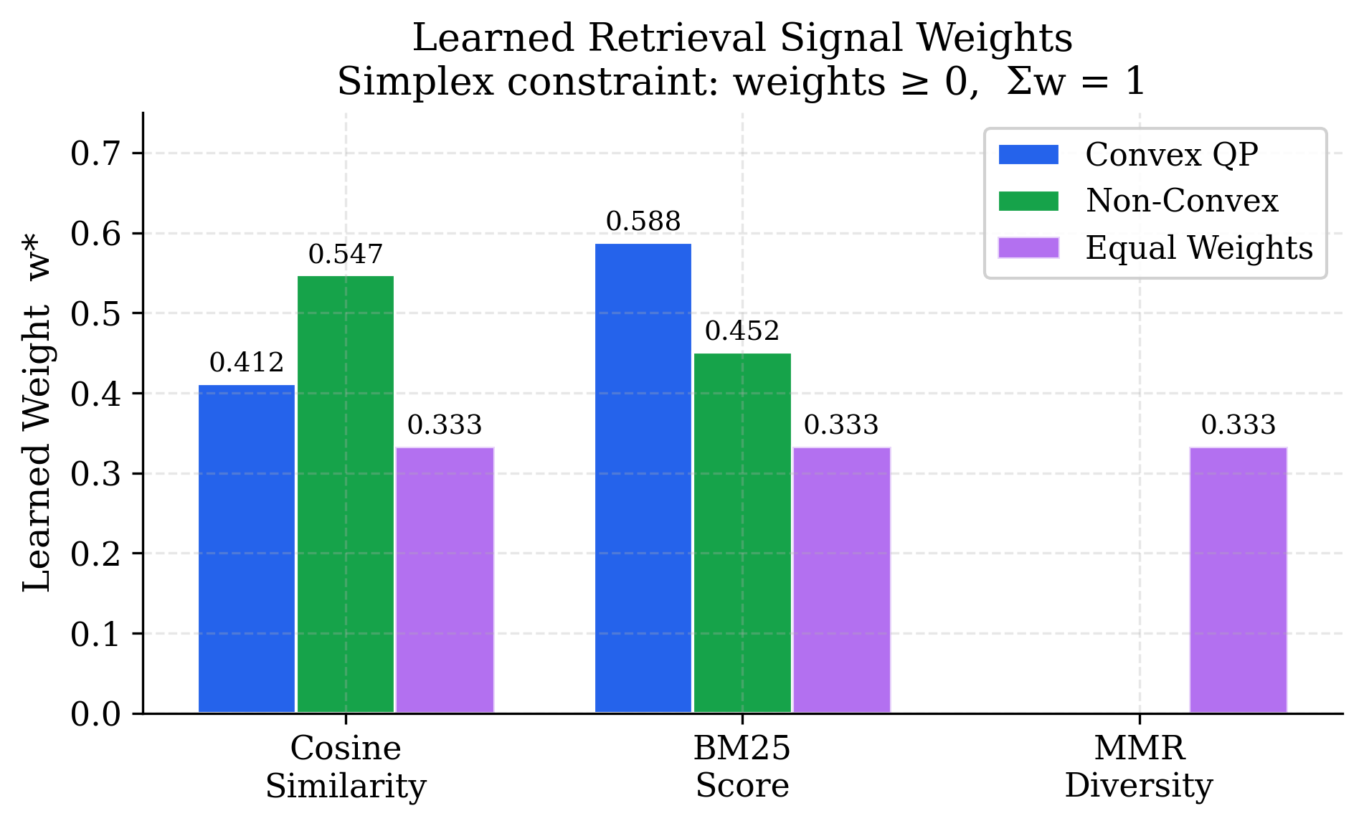
Learned Retrieval Weights
System | Cosine | BM25 | MMR
Convex QP | 0.412 | 0.588 | 0.000
Non-Convex | 0.547 | 0.452 | 0.001
Equal | 0.333 | 0.333 | 0.333
Key Insight
BM25 > cosine on factual QA, lexical overlap matters for trivia
MMR diversity weight → 0 via KKT complementary slackness
Both optimizers agree: diversity adds no value here

Slide 11
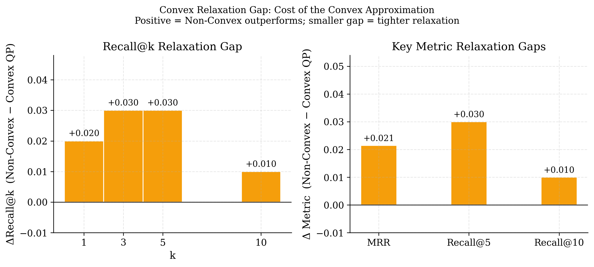
Convex Relaxation Gap
Gap on
Recall@5
3.0%
Convex QP: Recall@5 = 0.892
Non-Convex: Recall@5 = 0.922
Gap is small but real and consistent
Convex solution 1,000× faster to compute

Slide 12
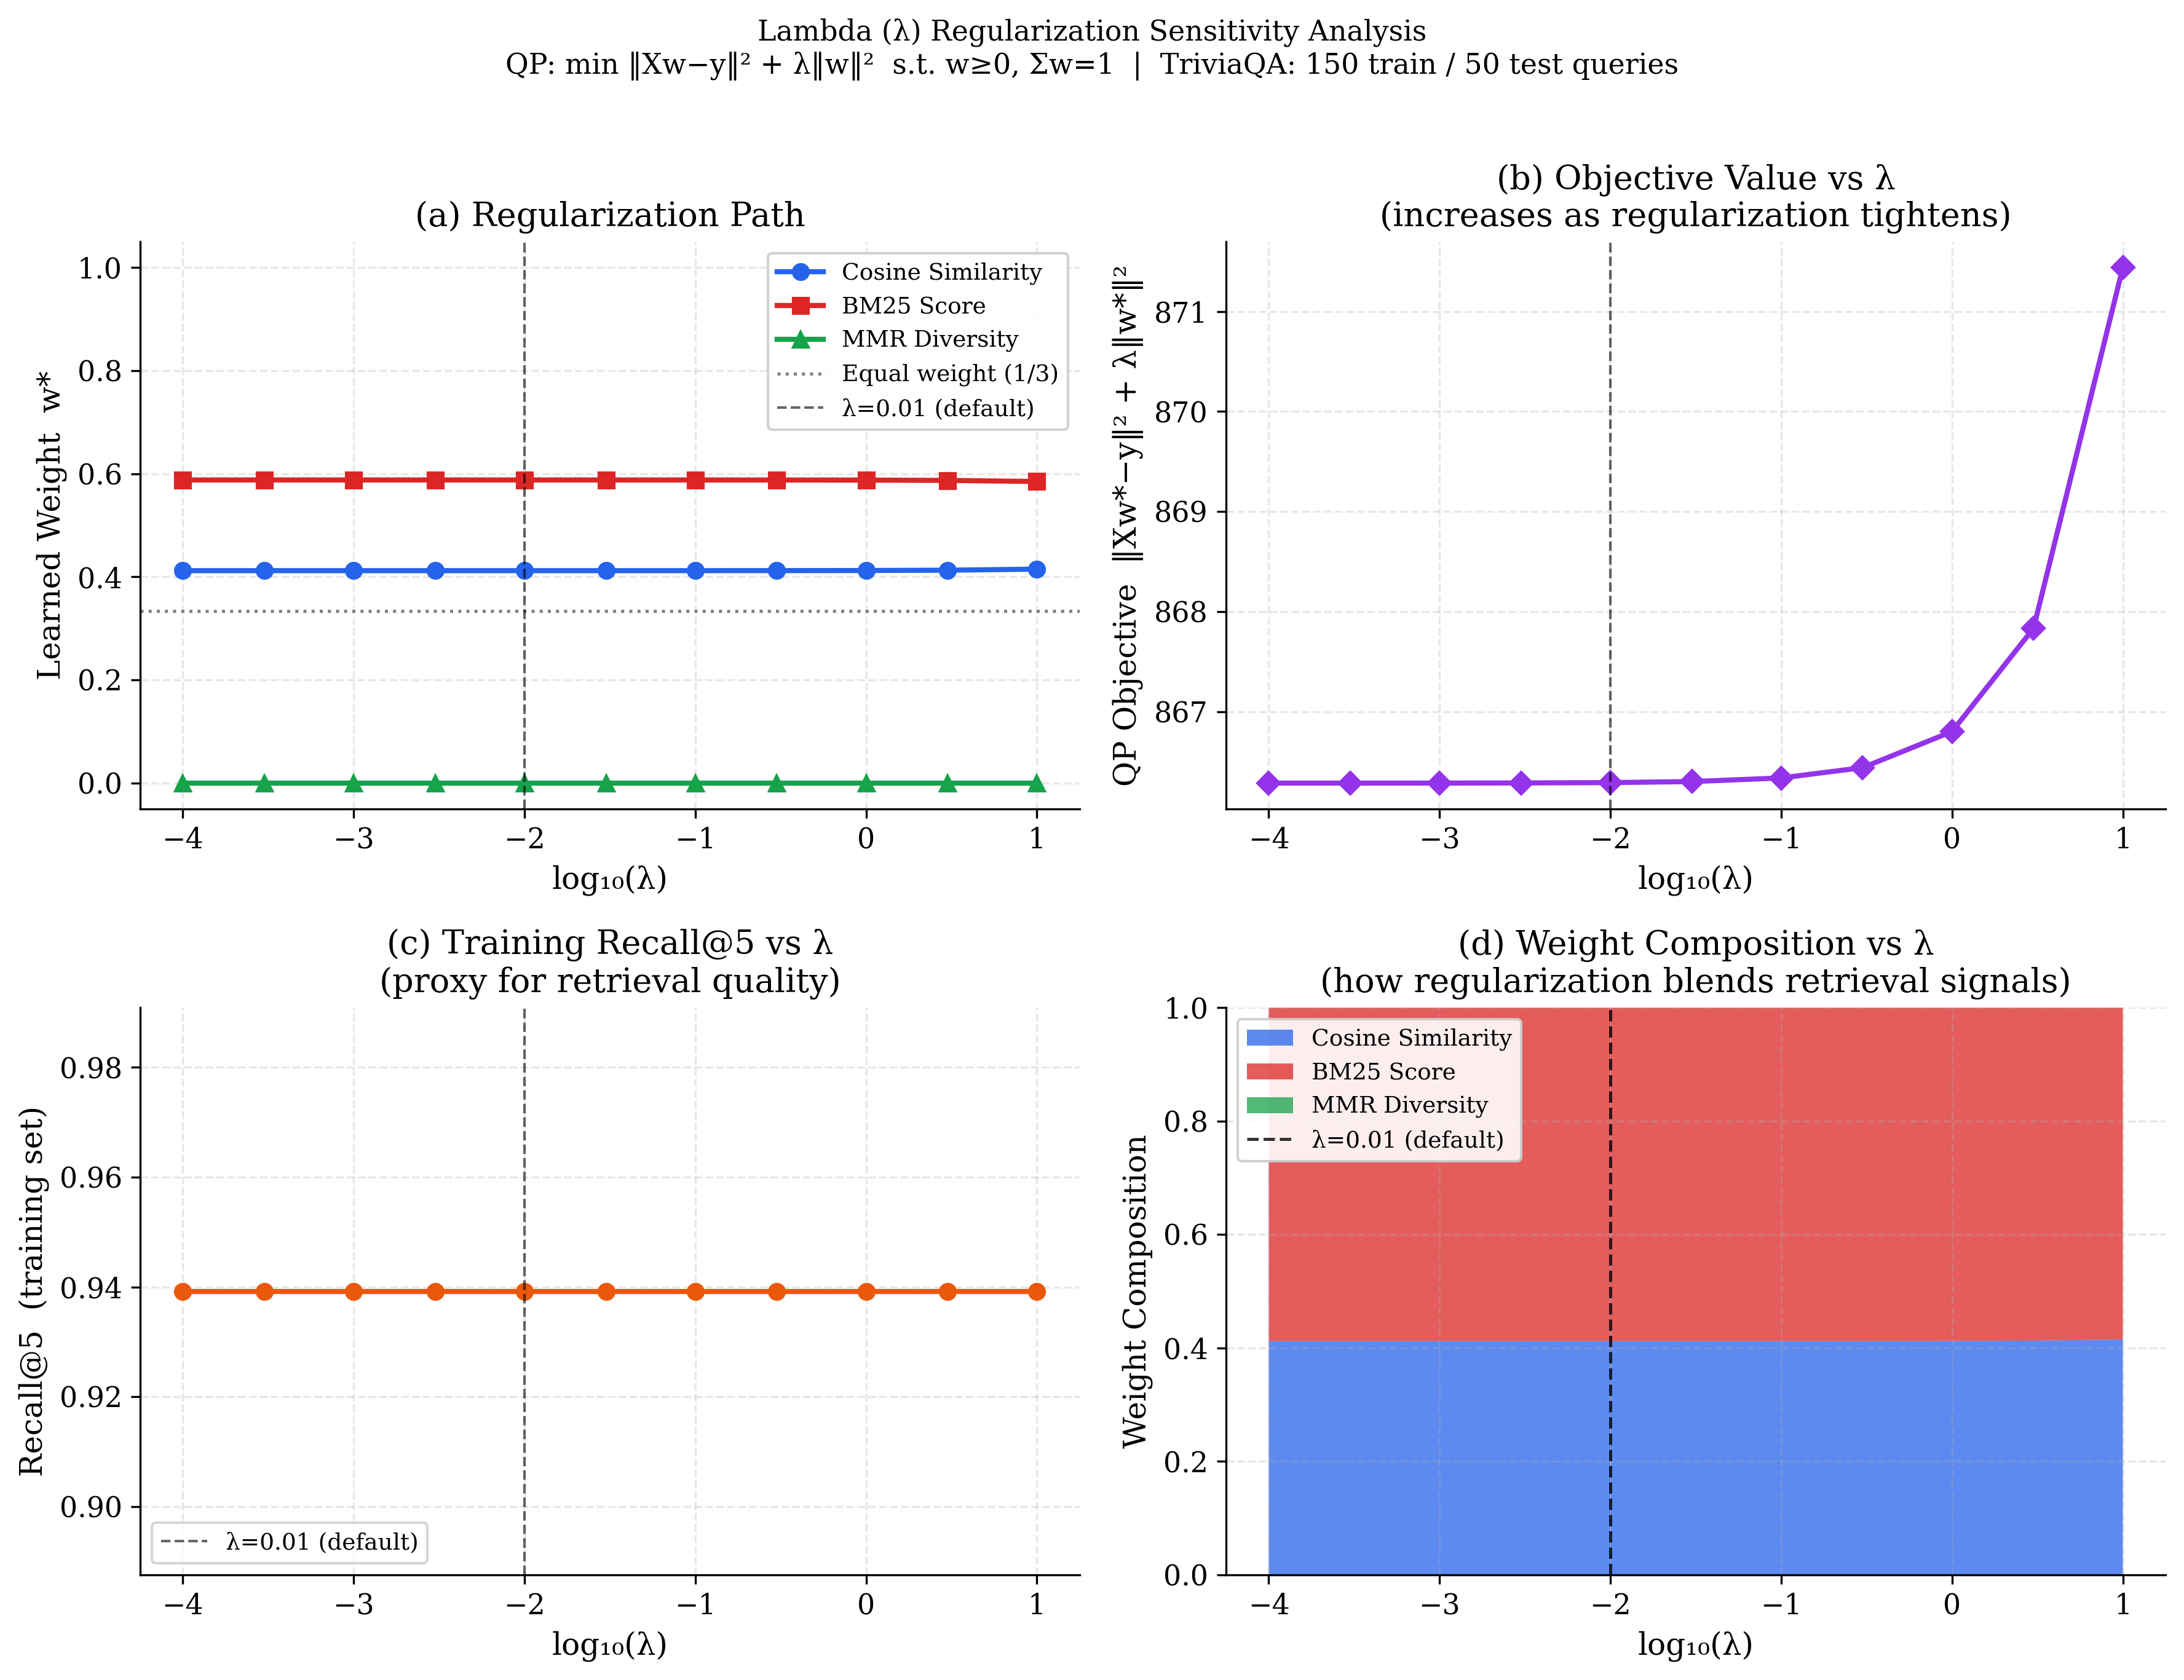
λ Regularization Sensitivity Analysis
λ sweep: 10⁻⁴ → 10¹
Weights stable
cosine & BM25 unchanged across 5 orders of magnitude
diversity = 0
persists at all λ, strong empirical confirmation of KKT result
Recall flat
Recall@5 ≈ 0.939 across all λ, robust to regularization choice
Practical value
λ = 0.01 (default) is a safe choice, results are insensitive

Slide 13
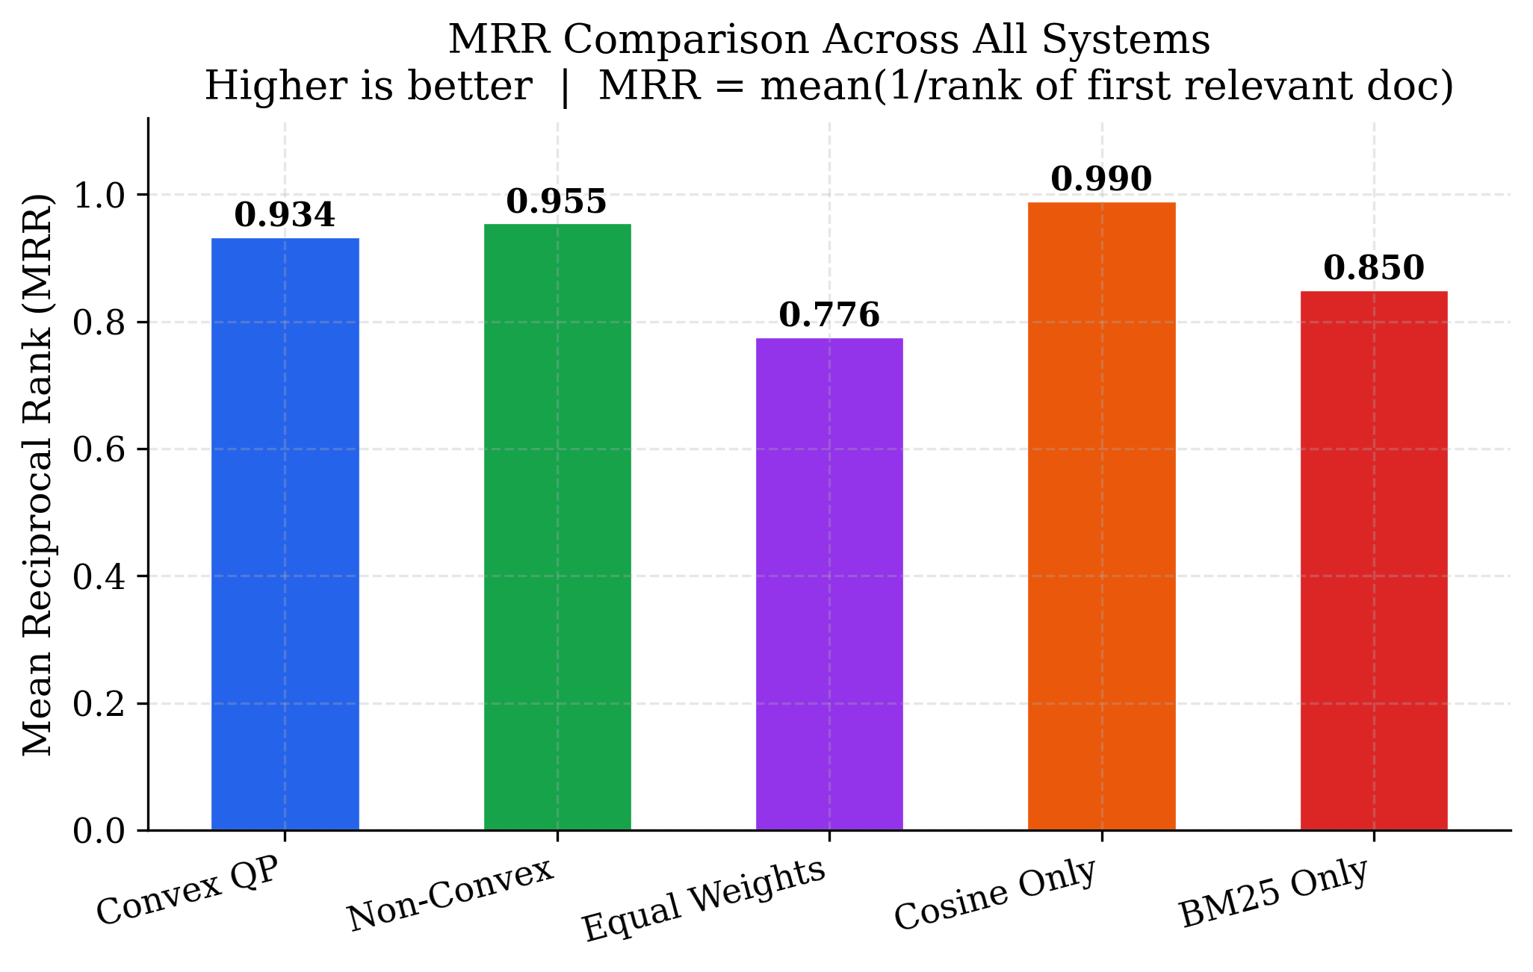
MRR & Full Metrics Comparison
System | R@1 | R@5 | MRR
Convex QP | 0.635 | 0.892 | 0.934
Non-Convex | 0.655 | 0.922 | 0.955
Equal Wt. | 0.500 | 0.685 | 0.776
Cosine Only | 0.705 | 0.929 | 0.990
BM25 Only | 0.580 | 0.779 | 0.850
Note: Cosine-only ranks highest because the embedding model was used to build the FAISS index, it dominates on this dataset without BM25 fusion trade-offs.

Slide 14
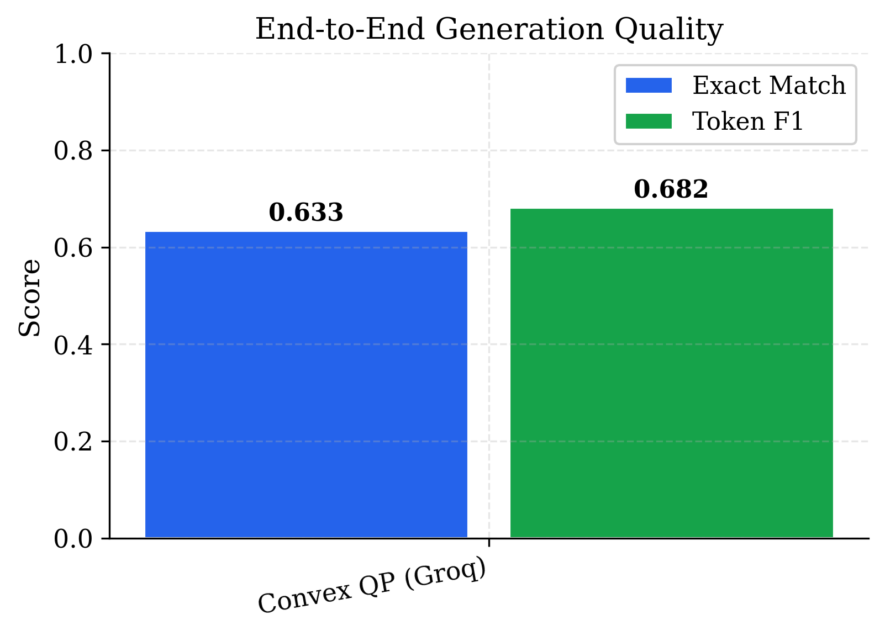
End-to-End Generation Quality
Convex QP + Groq
LLaMA-3.3-70B-Versatile
0.633
Exact Match
0.682
Token F1
30 test queries evaluated
Groq API inference in ~90s

Slide 15
Key Takeaways
01
03
The weight subproblem is strongly convex
MMR diversity weight = 0 (KKT + empirical)
Unique global minimum guaranteed, CVXPY solves it in milliseconds.
Complementary slackness confirms diversity adds no value for single-answer factual QA.
02
04
Convex relaxation gap is 3.0% on Recall@5
Lambda sensitivity: weights remarkably stable
Small but real; convex trades ~3% accuracy for ~1000× computational speed.
cosine/BM25 split unchanged across 5 orders of magnitude in λ, robust.
Code: github.com/Lord2709/RAG-Convex-Optimization

